Slide 1
Interim Advanced Webinar
Malina Monaco
Vice President
Vince O’Neill
Accreditation Director

Slide 2
If you have questions, make sure you add to question box. You will need to make sure you are logged in and not “anonymous”. I will respond to questions via email after the webinar.

Slide 3
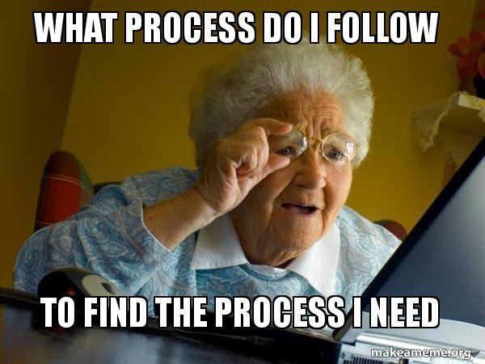
Is this where you are in your Interim Advanced Review Process?

Slide 4
Timelines
Tier A and B (Original visits prior to F2018)- Self Study is due January 2, 2021 Virtual Visit will be completed between March 1-August 30, 2021.
Tier C (Original visit F2018)- Self Study is due September 1, 2021 Virtual Visit will be completed between October 1, 2021-December 31, 2021.
Tier D (Original visit SP2019)-Self Study is due January 3, 2022 Virtual Visit will be completed between March 1, 2022- June 30, 2022.

Slide 5
Logistics
No fee for the Interim Advanced review
Virtual site visit teams= Lead + 1 SV (+1 State, if joint)
Letter of Agreement
Does not modify/change accreditation status for the next synced visit

Slide 6
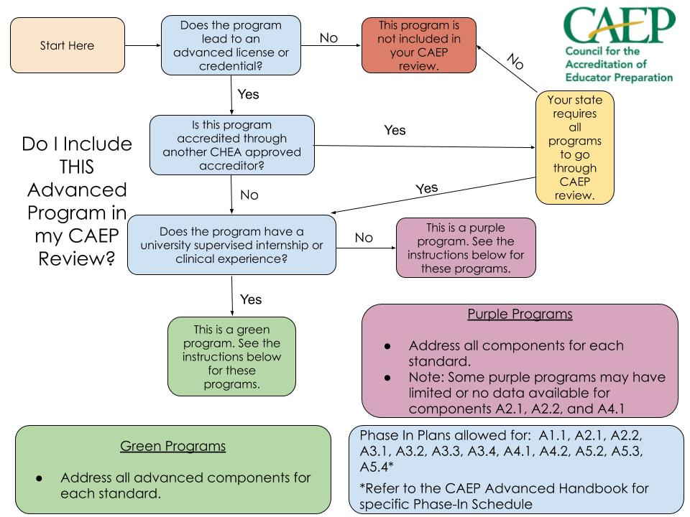
What programs do I include?
Must address all components for each standard ACROSS all of the Purple programs as a group.
On a visit, reviewers should see data for each standard for these programs.
Notes:
Malina

Slide 7
Interim Advanced Process
Self Study Report*
Formative Feedback Report
The Interim Advanced Process will follow the same steps as a regular site visit with a condensed timeline*. Cases will go to the Accreditation Council the following semester. AIMS templates are open for tiers A, B, and C.
Addendum
Virtual Visit
Rejoinder

Slide 8
Legacy Advanced AFIs
The SSR WILL include legacy advanced AFIs from previous review.
EPP will address within the CAEP Advanced Standards (reference which standard)
If the legacy AFI is no longer part of CAEP standards please indicate that in the rationale.

Slide 9
Advanced Standards Assessment
Common assessments - For initial programs assessments are common across program typically but advanced program may have different assessments for each program.
How many?- State guidance and feasibility. Ensure you are collecting useable data and not just data.
Standard A1.1- You need to ADDRESS all 6 proficiencies but only ASSESS 3 of them in your curriculum map.
Align Assessments to existing milestones or activities

Slide 10
Importance of Plans to Advanced Reviews
A.1.1, Advanced preparation candidate knowledge and skills in their professional specialization field
A.2.1, clinical partnerships
A.2.2, clinical experiences
A.3.1, admission of diverse candidates who meet employment needs
A.3.2, demonstrate academic achievement and ability to complete parathion successfully
A.3.3, candidate progress during preparation
A.3.4, professional and ethical preparation
A.4.1, employer satisfaction with preparation and employment persistence of completers
A.4.2, completer satisfaction with preparation
A5.2 relevant, verifiable, representative, cumulative
A.5.3, testing innovations as part of Standard 5, continuous improvement
A.5.4, CAEP outcome measures: licensure, completion placement, consumer information

Slide 11
Advanced Components NOT Under Plans
A.1.2 - Professional Responsibilities- SPA/State Approval/Content data
A.5.1 - Quality Assurance System (Process/Evidence)
A.5.5 - Stakeholder involvement in Quality Assurance System(Process/Evidence)
Notes:
Perhaps add language of the component if fits.

Slide 12
CAEP Sufficient Plans Include
Relationship to CAEP Standard or Component
Timeline and Resources
Data Quality
“I plan to do some stuff sometime before my next visit.”
“I plan to do that.”

Slide 13
Relationship to CAEP Standard
An explicit link of the intended data/evidence to the standard or component it is meant to inform; self-studies will tag the evidence to the appropriate standard;
A description of the content and objective of the data/evidence collection

Slide 14
Timeline and Resources
Detailing of strategies, steps and a schedule for collection through full implementation, and indication of what is to be available by the time the site visit;
Specification of additional data/evidence that will become available in the calendar years following accreditation until completion of the phase-in plan steps.
A description of the personnel, technology and other resources available; institutional review board approvals, if appropriate; and EPP access to data compilation and analysis capability.

Slide 15
Data Quality
A copy of the collection instrument if it is available, together with information called for in CAEP instrument review rubrics;
Description of procedures to ensure that surveys and assessments reach level 3 or above on the CAEP assessment rubric;
Steps that will be taken to attain a representative response, including the actions to select and follow up a representative sample (or, a purposeful sample if that is appropriate for the data collection) and actions to ensure a high response rate;
Steps to ensure content validity and to validate the interpretations made of the data;
Steps to analyze and interpret the findings and make use of them for continuous improvement.

Slide 16
Example of a Template

Slide 17
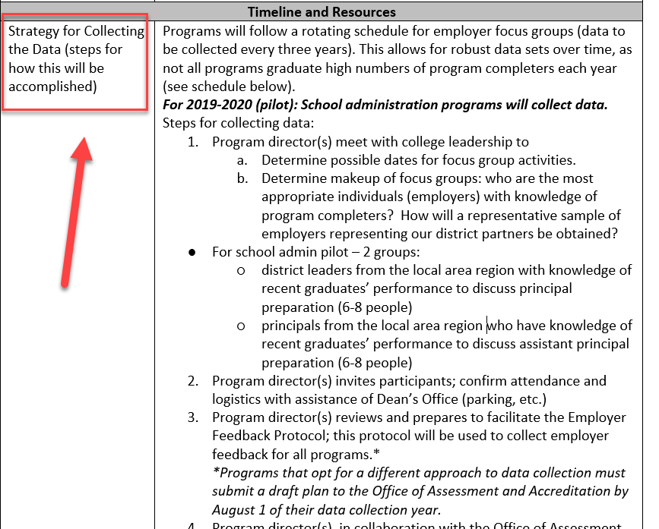

Slide 18
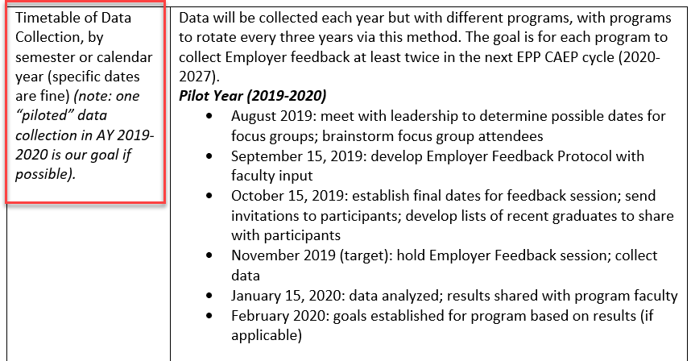

Slide 19
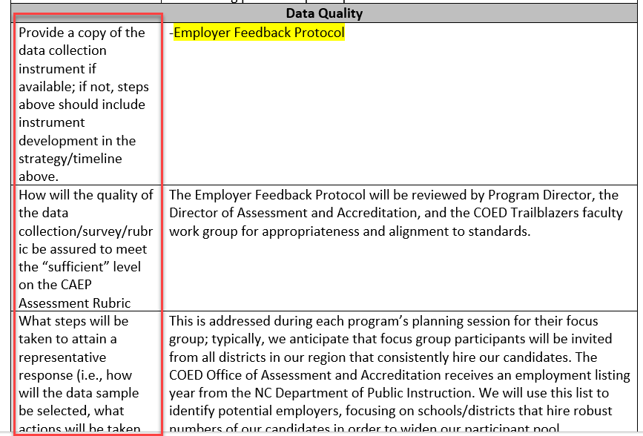
Things to complete in template….
TBD
TBD

Slide 20
Evidences to support your narrative
Label Phase in plans by component/standard
There may be just a few evidences per standard
Teams will not have access to previous reviews so make sure you upload any previous evidences you wish them to review (especially important for St 5/A5)

Slide 21
CAEPCON

Slide 22
Who do I contact if I have questions?
Me! I am the case manager for interim advanced visits.
Dr. Malina Monaco
Vice President for Accreditation
Malina.Monaco@caepnet.org

